Slide 1
Information and Support for Families and Friends
Research Grant Opportunity
Melinda Lucas
Notes:
Please zoom out for icon options to use on this slide.

Slide 2
Background of project
The ADF is delivering a small grant program on behalf of the Australian Government to build capacity to further develop evidence for support and information to family and friends of people who use AOD.

Slide 3
We completed a review of information and support services for family and friends

Slide 4
We explored what information and support is currently available and the range of service offerings and delivery.
We learnt from families and friends who had accessed services about what had worked for them and what the barriers might be for those who haven’t sought help.
And, we identified that there is little published evidence of what works - despite the dedicated work that so many services currently do.

Slide 5
This new ISS Grants Program is designed to demonstrate the impact of that work, or new initiatives, to help build a strong evidence base that will lead to better outcomes for families and friends.

Slide 6
Research Grant Program
We are inviting Expressions of Interest for projects of up to $50,000, up to $100,000 or $200,000.

Slide 7
Research grants
This program will build on the existing evidence base by providing grants to:
Established programs or organisations that have demonstrated experience in evaluation and/or strong academic partnerships; or
Organisations who wish to trial the transferability of existing family and friends programs to the AOD sector (specific to supporting families/friends of people who use AOD).
Only a short indication of interest is required by April 30 using the online form, not a formal submission.

Slide 8
What the grant will cover
Successful applicants will receive funding to:
Provide further evidence of impact, evidence of translation to different populations or settings or innovations to increase impact or reach of an existing program.
Strengthen the evidence of existing programs or projects that focus on delivery of information and/or support for family and friends.
Fast track expansion of an existing program.
Innovative new idea to meet the support and information needs of family and friends.

Slide 9
What is selection criteria?
An existing service that is delivering information and/or support services to family and friends of people with AOD issues or concerns or information needs.
A ready-to-go research project or feasibility study that can be delivered within 12 months.
Have existing pilot data or track record that supports the suggested approach.
Willingness to share findings publicly.
Ability to process relevant ethics approvals in the timeframe.

Slide 10
APPLICATION PROCESS – Initial Expression of Interest
STAGE ONE
Your short EOI will need to include the following information:
What is the service / program you are currently running? (50 words)
Plain language research summary (Max 200 words)
The research question (50 words)
Plain language overview of the methodology - participants, data, design, planned analysis (200 words)
Approach to ethics (100 words)
Track record of research team (200 words)
Nature of partnership between service provider and academic group (if relevant)
Budget

Slide 11
APPLICATION PROCESS
STAGE 2
Shortlisted applicants will be invited to provide a more detailed research plan which will need to include the following information:
What is the service under investigation?
What is the existing evidence for this approach? (published)
What is the likely impact of getting more evidence for this service, what will it change or strengthen?
Track record of service provider in evaluation
Proposed methodology
Design
Measures
Participants
Approach to ethics
Budget
Role of partners (academic and service provider).
Applications will be assessed by an independent expert panel

Slide 12
Timeline & Key Dates
20th April - Expressions of interest open
30th April – Expressions of interest close
4th May (w/c) – Shortlisted applicants invited to submit a detailed application
23rd June – Final application selection
May 2022 – Selected projects to be completed and ready to present at ADF Symposium

Slide 13
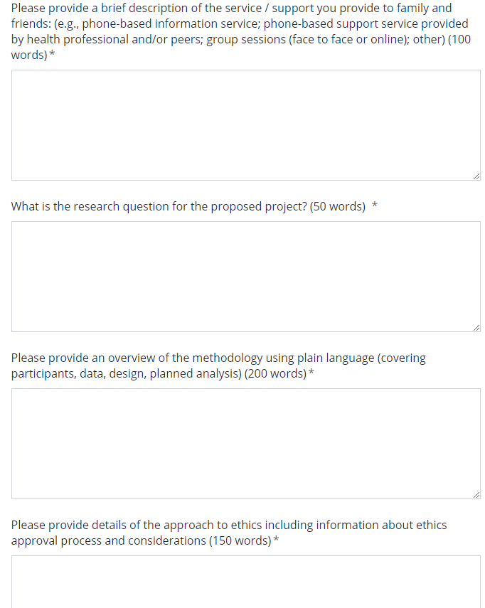
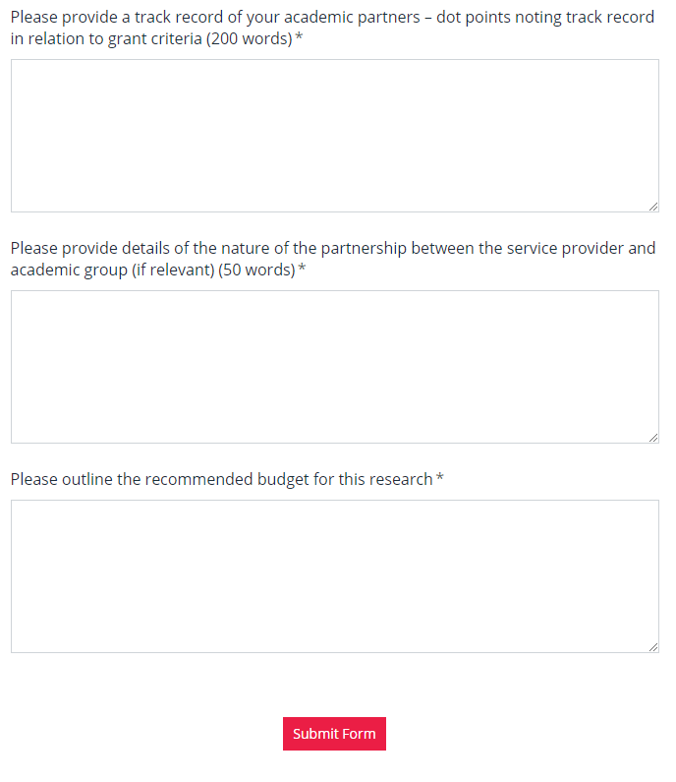

Slide 14
Questions?
grants@adf.org.au

